Slide 1


JavaScript Basics
Loops
Conditions

Slide 2
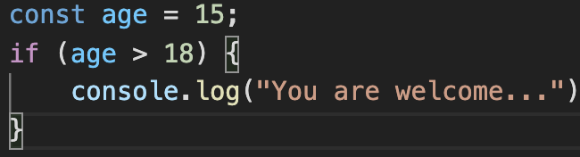
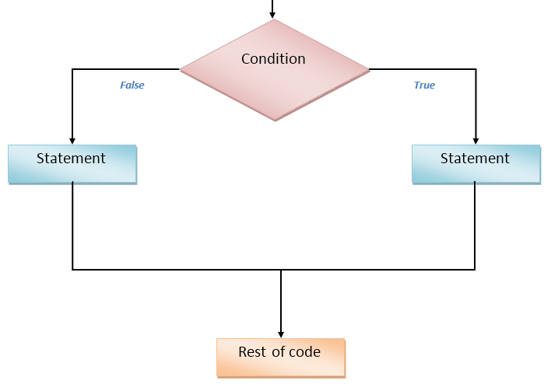
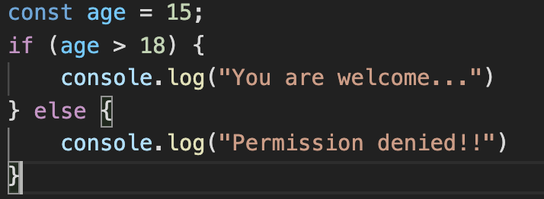
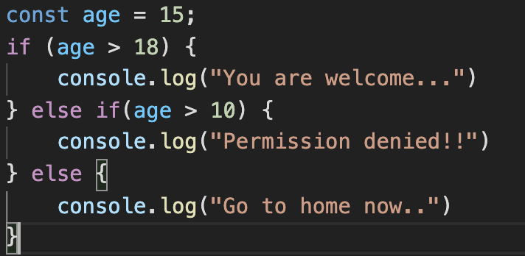
Conditions

Slide 3
Exercises
Check if number is odd or even
Check if prompt variable is a number or not
Find the largest of three number
Check number is present in given range
5. Write a JavaScript conditional statement to sort three numbers.
Display an alert box to show the result.

Slide 4
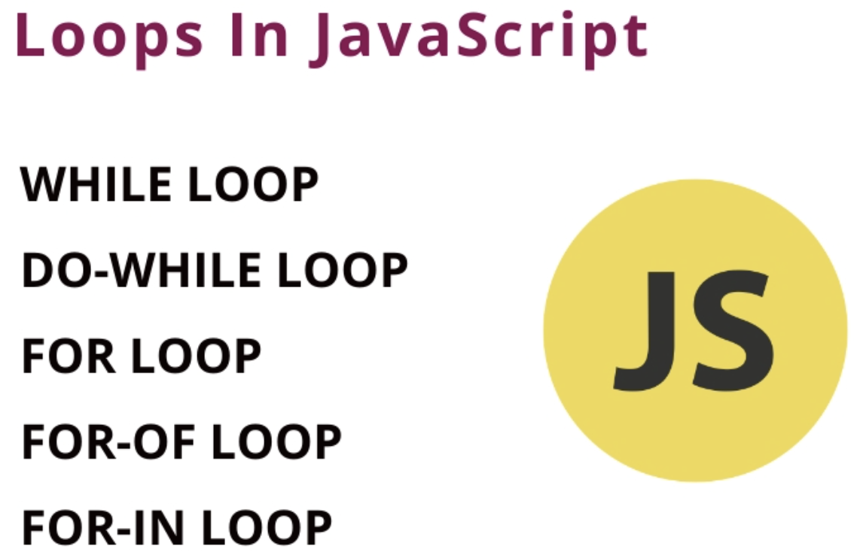

Slide 5
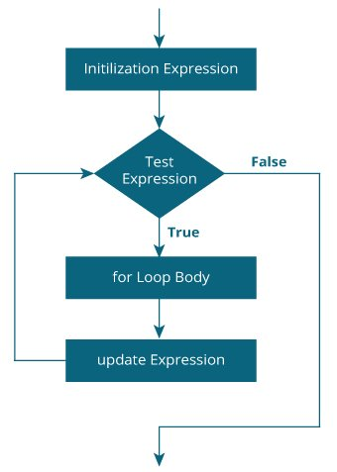
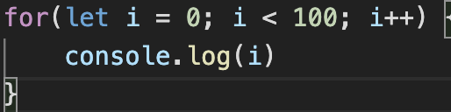
For Loop
break;
continue

Slide 6
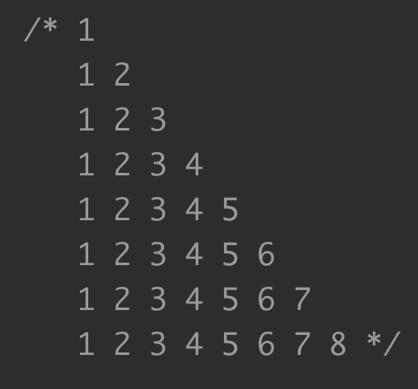
Tasks
Print all odd numbers from 0 – 100
Write a JS code to find the power of a number using for loop.
Print given number digits using for loop.

Slide 7
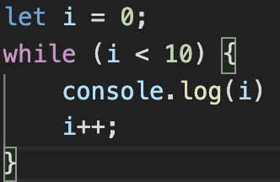
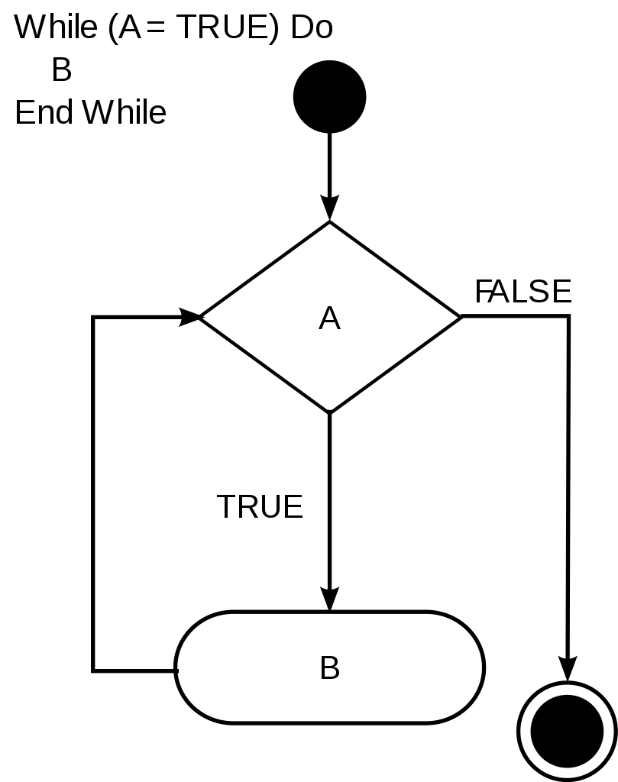
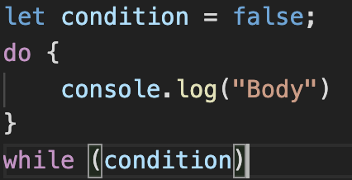
While loop

Slide 8
Tasks
Write a JS code to print numbers from 1 to 10 (using while)
Greatest common divisor
Write a JS code to calculate the sum of digits in a number (using while)

